Slide 1
Advanced Leopard Seal Recognition System (ALSRS): Sprint 2
Bryce Robinson, Carson Buntin, Carsyn Smeda, Nathan Hontz, Juncheng Li, Ryan Huntington
Notes:
Carson

Slide 2
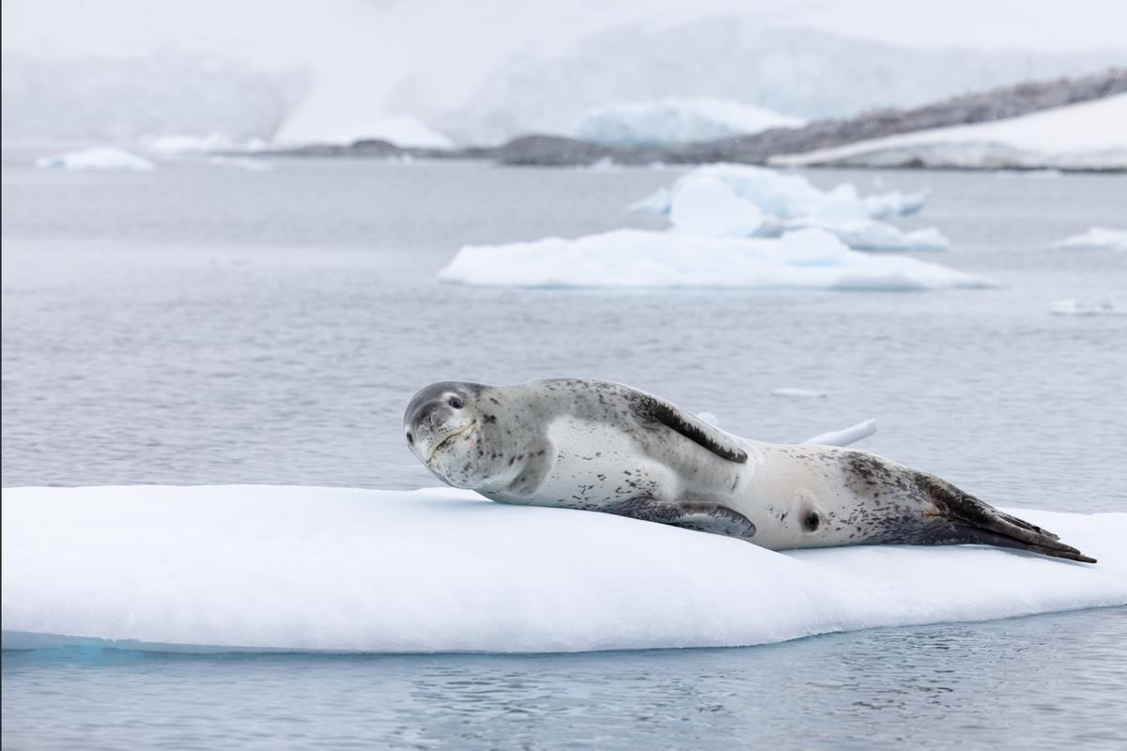
Project Review
Current lack of effective tools to detect and identify individual leopard seals
Develop API for Happywhale.com capable of receiving leopard seal photographs and returning the identity of any recognized seals
Utilization of two machine learning models for detection and identification of leopard seals
Notes:
Carson

Slide 3
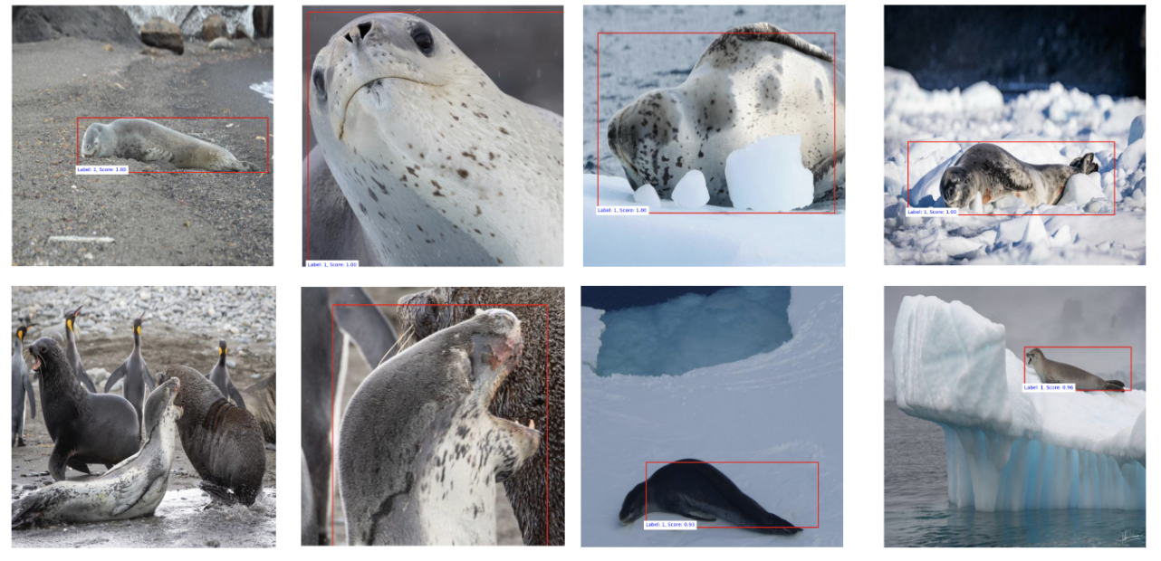
Faster R-CNN (Detection Competitor)
Notes:
Juncheng

Slide 4
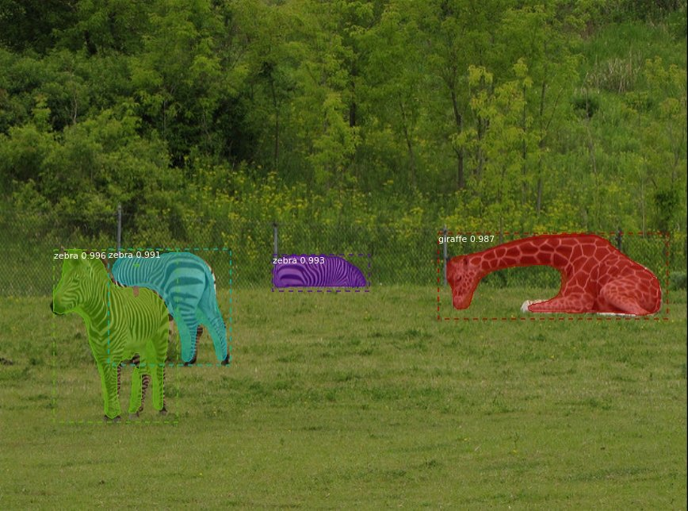
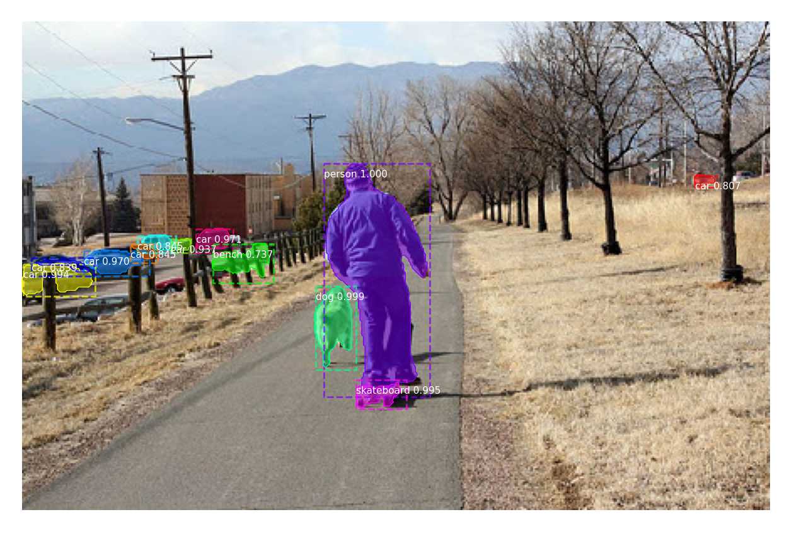
Mask R-CNN (Detection Competitor)
Version of Faster R-CNN that outputs object mask
Requires bounding boxes and masks to train model
Notes:
Nathan

Slide 5
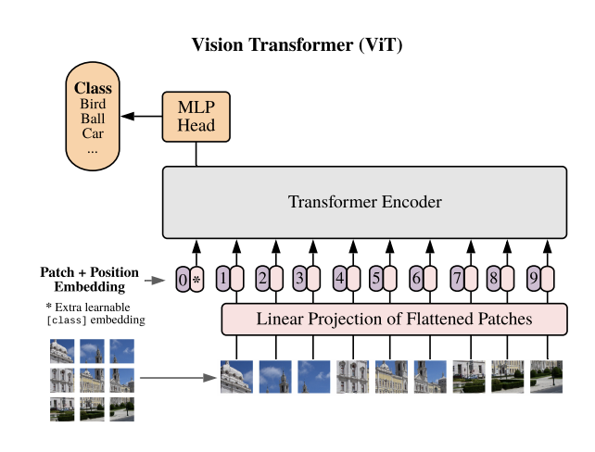
ViT (Identification Baseline)
Vision Transformer - image recognition model
Used to classify seal images by their spot patterns, returning the unique ID of that individual
Can also return embeddings, which may be used to identify unlabeled individuals
Notes:
Carsyn
Vision transformers have extensive applications in popular image recognition tasks such as object detection, image segmentation, image classification, and action recognition.

Slide 6
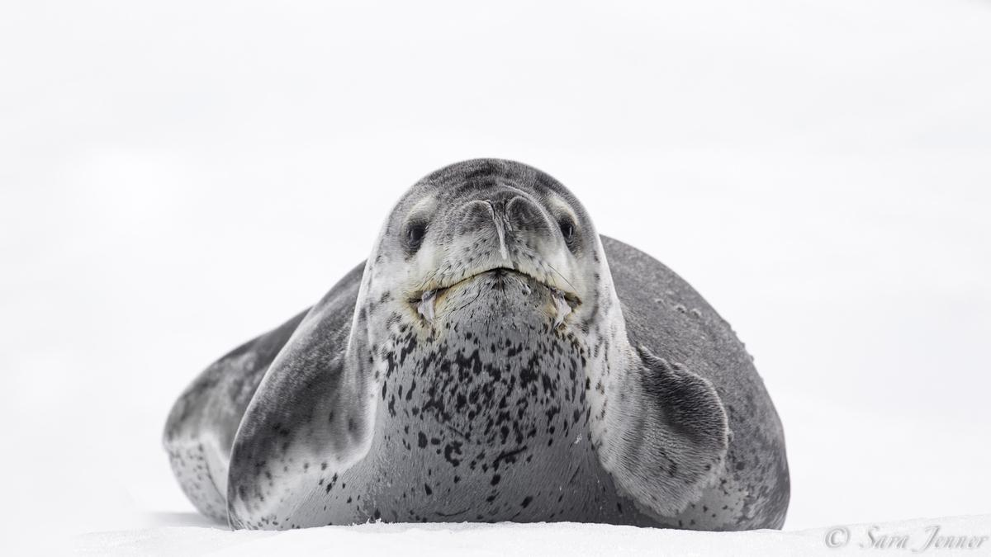
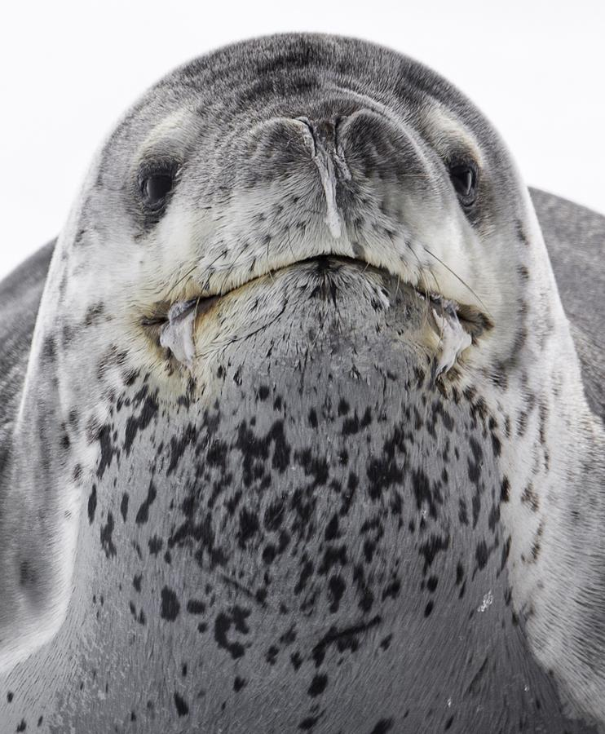
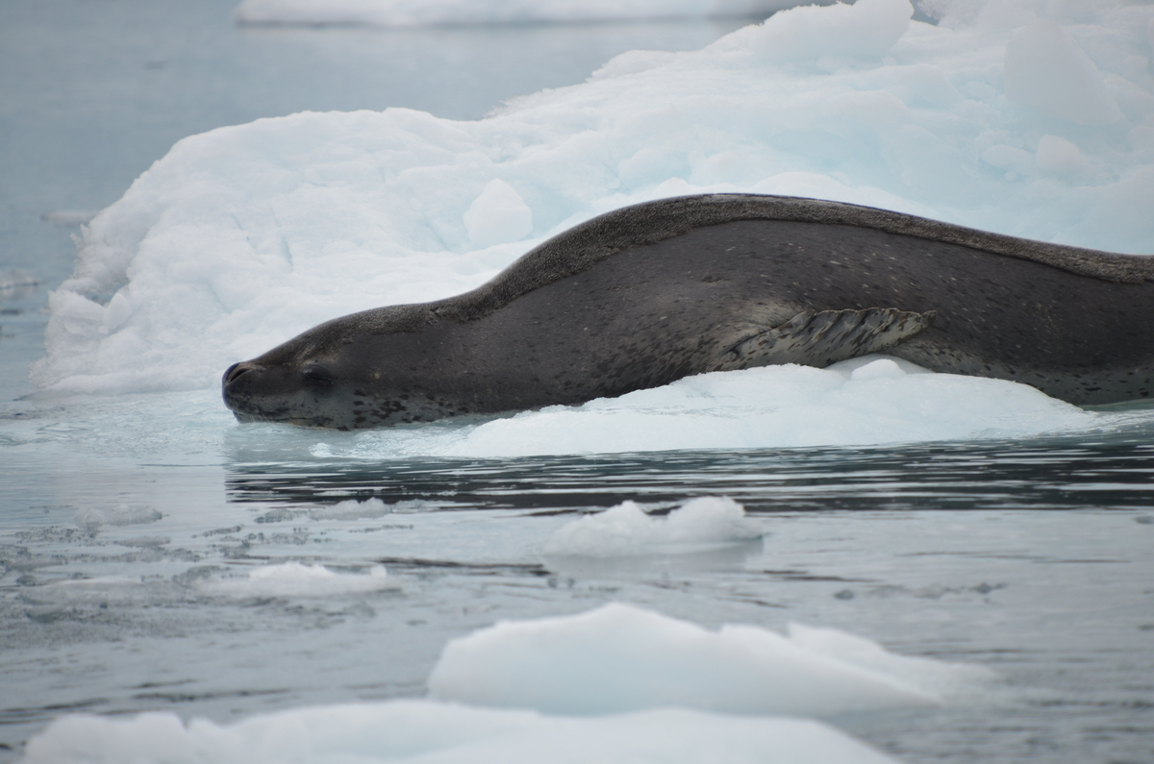
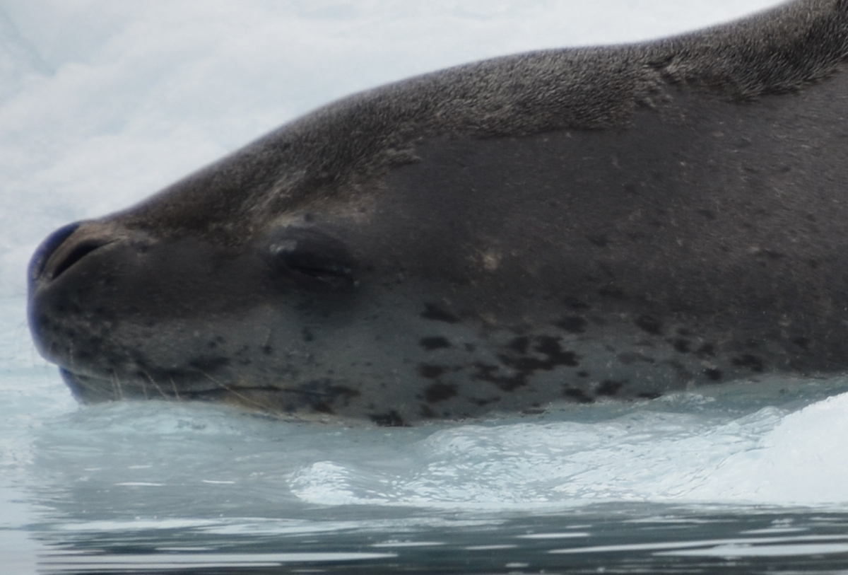
Generation of ViT Dataset
Finding multiple encounters of the same seal
Finding images with appropriate features for identification
Downloading and preprocessing images for ViT input
Notes:
Carsyn (these two are the same seal and two different encounters)

Slide 7
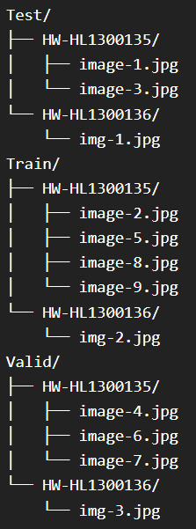
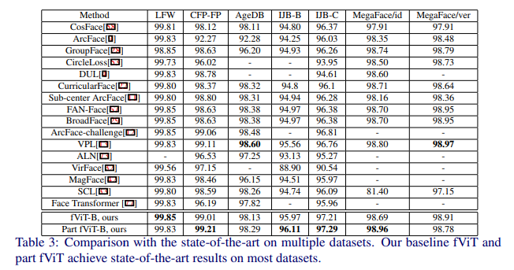
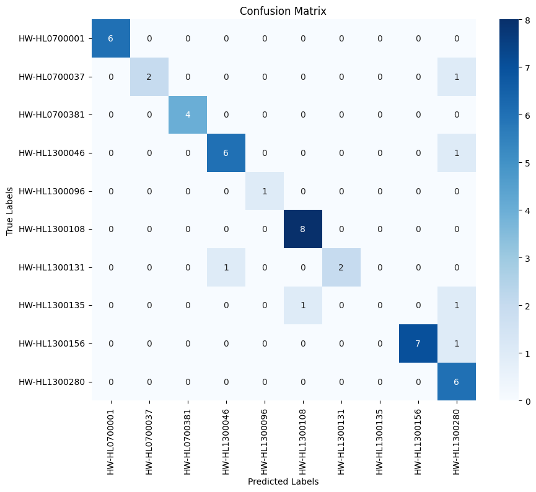
ViT Testing
Dataset organized by individual
Achieves high accuracy facial recognition
Notes:
Ryan

Slide 8
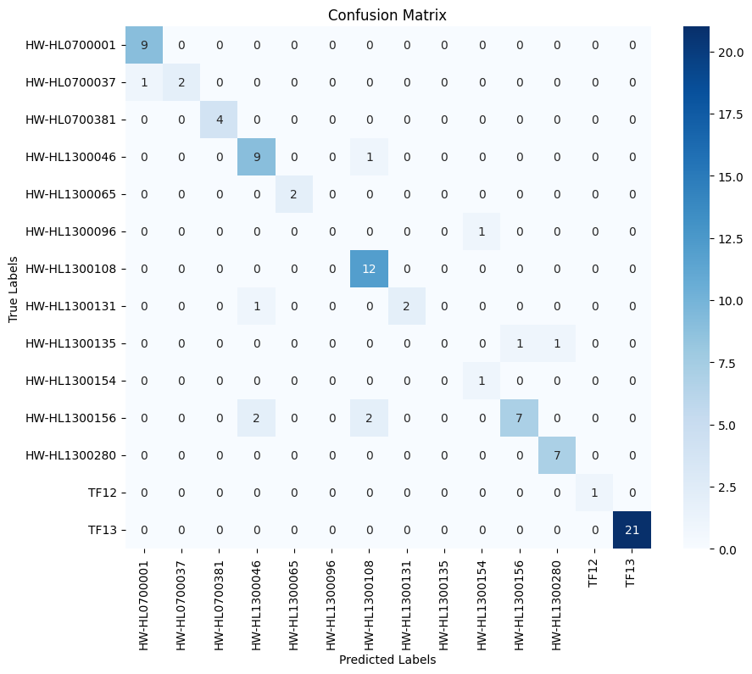
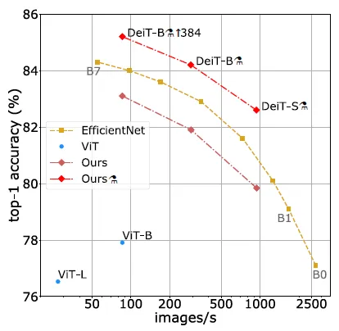
DeiT (Data-efficient Image Transformer)
Replacement algorithm to ViT
Hard distillation and distillation token
Notes:
Ryan

Slide 9
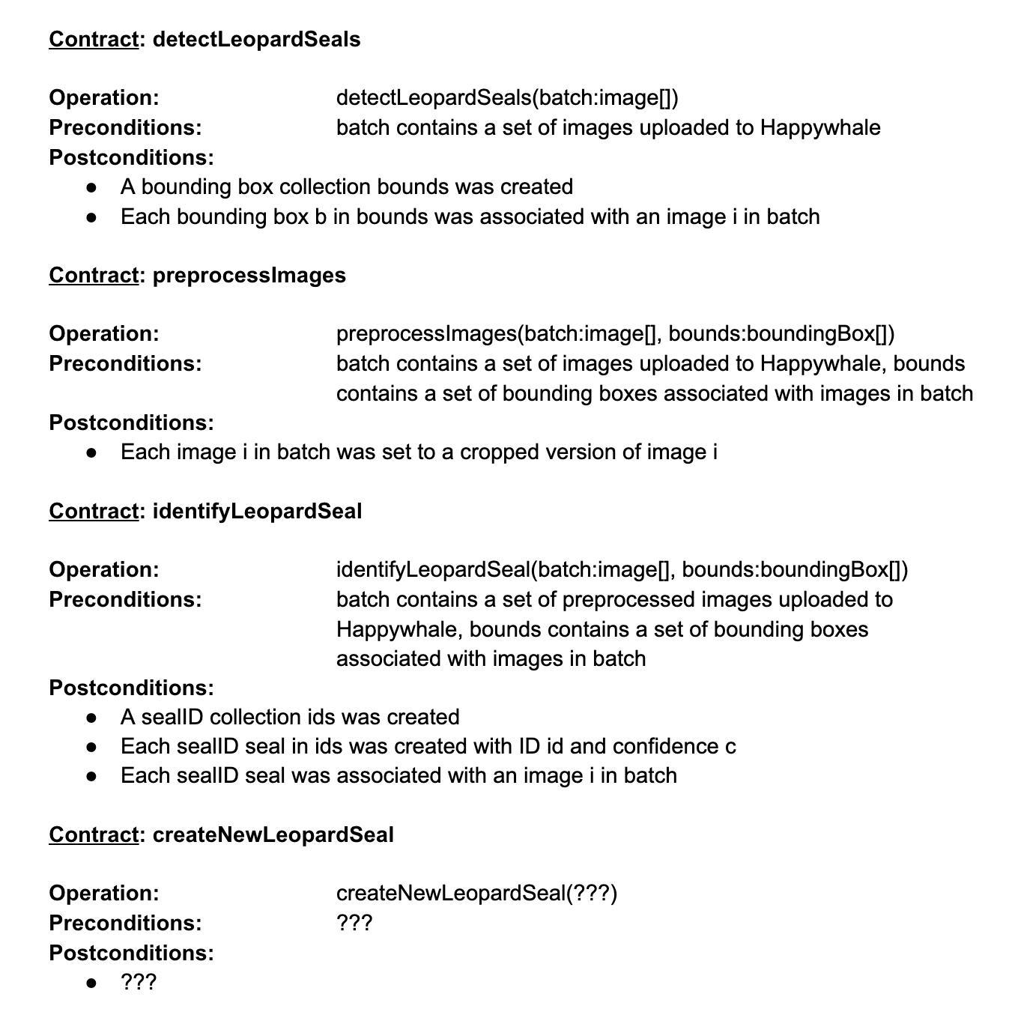
API Planning
Questions for Happywhale about existing architectures and API functionalities/constraints
Proposed Operation Contracts
Preliminary API Assumptions
Notes:
Bryce

Slide 10
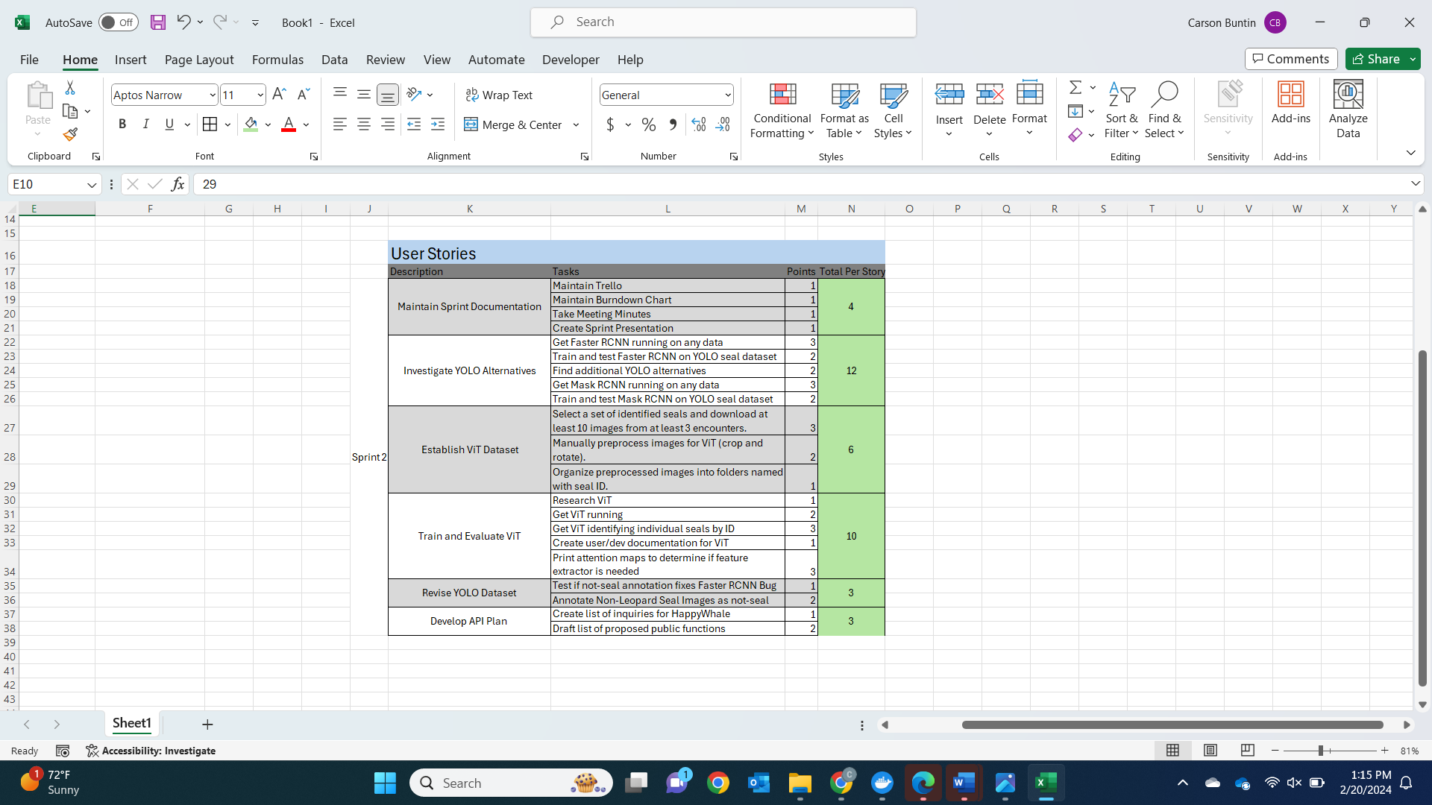
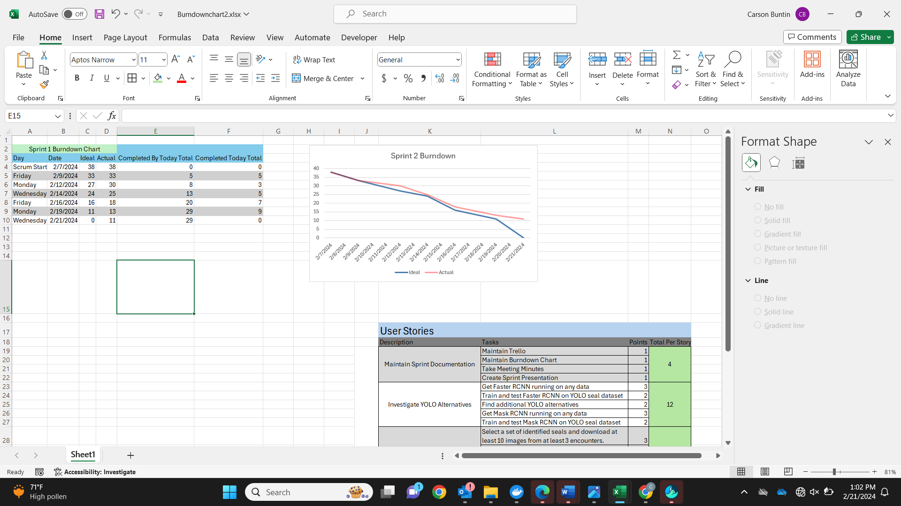
Burndown Chart and User Stories
Notes:
Carson

Slide 11
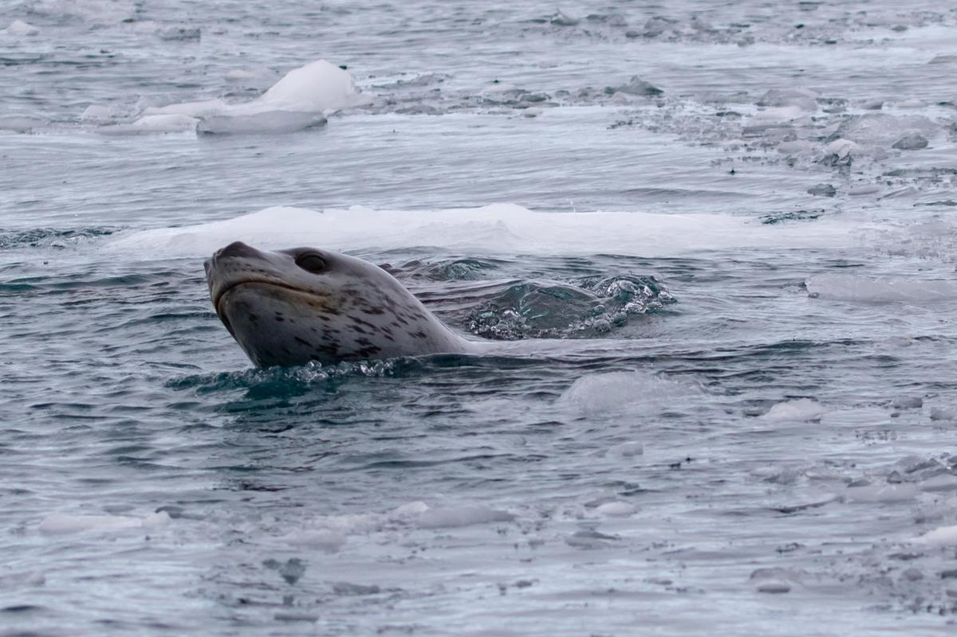
Next Sprint
Revise detection dataset with Mask annotations
Performance analysis of Faster R-CNN and Mask R-CNN
Complete identification dataset
Investigate and test ViT alternatives
Begin API development and model integration
Notes:
Bryce

Slide 12
Questions

